Slide 1

TITLE
Author’s Name
^{Department name}
Abstract
Material and Methods
Results
Conclusion
How did you collect your data
What were the methods used
You can choose to have links here to further explain your materials or methods as well
Slide/poster size is 23.04X40.97
Minimum font: 28pt (this may seem large, but at this poster size it’s not)
Recommended font Types: Calibri, Arial, Times New Roman
This is only a template. All content may be modified, except for slide dimensions
If you are creating your e-poster on a PC, please make sure to save your formulas as an image and embed it into your presentation or they will change on our Macs.
Enter your results here
Enter conclusion here
Click Headings to View More Information

Slide 2
Abstract
Enter description of Graph/Image here
Category 1 of abstract
Explain abstract here.
A
G
Category 2 of abstact
A
A
A
Explain abstract here.
A
A
A
A
A
A
G
A
A
G
G
A
G
G
A
Description of your graph or image here.
References: Enter your references for your abstact here

Slide 3

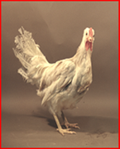
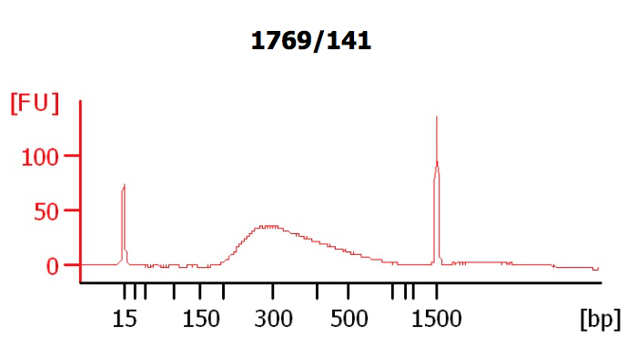
Material and Methods
Materials description here and add picture below
Workflow (Use interactive images of materials used or videos)
Fayoumi
Leghorn
Samples
Sequencing
Sample
Sample
Data analysis
Description of image here
Samples
Data Analysis
Insert Description of Materials and Methods here.
You can bullet point information or write in a long paragraph
The text box can be moved in any direction you see fit.
You can add less images and more text if you wish to.
If you have more information that will not fit into this page, you can hyperlink images to create larger version in a new slide or you can add more content by adding a navigational button leading to “next slide”.
Title of your video

Slide 4
Results
Figure 1. Description of figure one here.
Table 1.Title of table one here.
Sample | Testable loci | ASE SNPs | Paternally preferred ASE SNPs | Maternally preferred ASE SNPs
FL_BR_S1 | 52,651 | 4,252 | 2,060 | 2,192
FL_BR_S2 | 56,314 | 4,730 | 2,329 | 2,401
FL_BR_S3 | 51,099 | 4,529 | 2,268 | 2,261
FL_BR_S4 | 46,742 | 3,841 | 1,939 | 1,902
LF_BR_S1 | 45,020 | 4,049 | 2,041 | 2,008
LF_BR_S2 | 55,961 | 4,922 | 2,469 | 2,453
LF_BR_S3 | 52,587 | 4,547 | 2,277 | 2,270
LF_BR_S4 | 55,108 | 4,197 | 2,129 | 2,068
FL_LV_S1 | 28,247 | 2,893 | 1,504 | 1,389
FL_LV_S2 | 25,970 | 2,634 | 1,329 | 1,305
FL_LV_S3 | 34,616 | 3,597 | 1,877 | 1,720
FL_LV_S4 | 26,845 | 2,486 | 1,241 | 1,245
LF_LV_S1 | 33,675 | 3,476 | 1,728 | 1,748
LF_LV_S2 | 33,208 | 3,359 | 1,717 | 1,642
LF_LV_S3 | 33,263 | 3,313 | 1,604 | 1,709
LF_LV_S4 | 26,861 | 2,333 | 1,178 | 1,155
a. Description of graph a. b. Description of graph B
Figure 2. Description of figure two here.
Long descruption of table one here
More information regarding results here

Slide 5
Results
Figure 3. Title for figure three here
Figure 3. Title for figure three here.
FL_LV_S2
Table 2. Title for table two here
Categories | ASE SNPs | ASE SNPs with consistent preferred allele | ASE SNPs | ASE SNPs with consistent preferred allele
Observed in 2 samples | 4,492 | 3,630 | 2,439 | 2,067
Observed in 3 samples | 1,431 | 1,218 | 904 | 825
Observed in 4 samples | 577 | 544 | 488 | 474
Observed in 5 samples | 311 | 308 | 311 | 308
Observed in 6 samples | 194 | 192 | 245 | 244
Observed in 7 samples | 120 | 120 | 237 | 236
Observed in 8 samples | 124 | 122 | 221 | 219
a. Description of image here

